Slide 1
Celebrity Face Detection

Slide 2
Data Collection
Data Pre Processing
Feature Extraction
Facenet (InceptionResNetV2)
VGG16 (Transfer Learning)
Face Recognition

Slide 3
Data Collection
Crawler
Library :icrawler.builtin(icrawler 0.6.7)
BingImageCrawler
GoogleImageCrawler

Slide 4





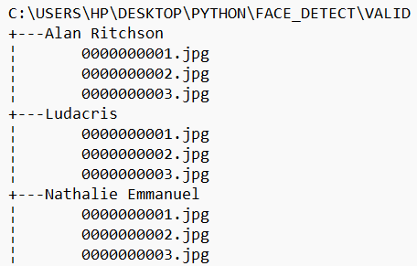
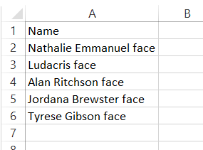
Crawler

Slide 5
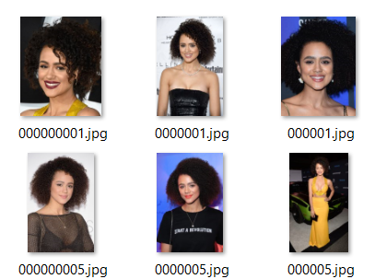

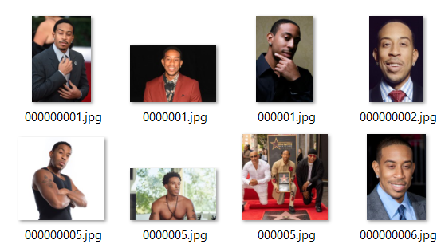
Raw Data

Slide 6
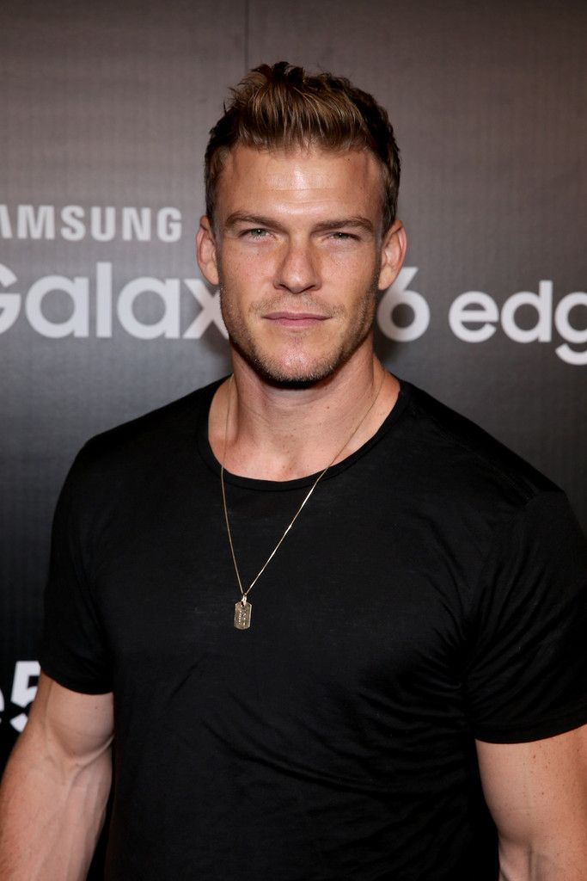
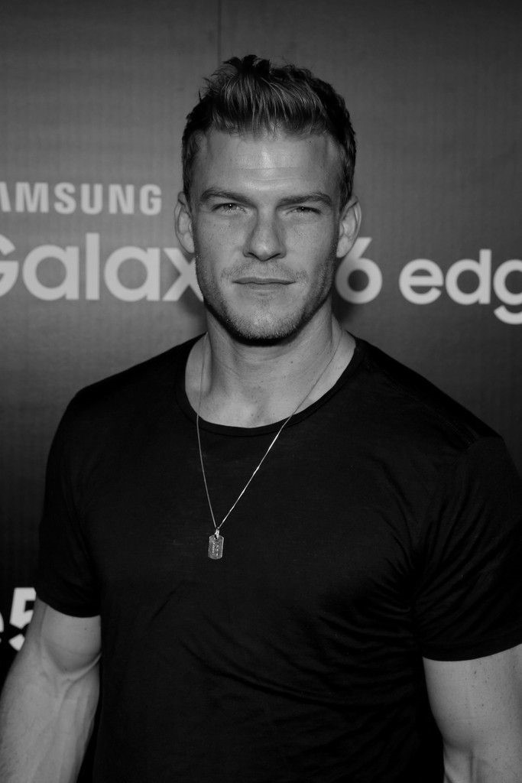
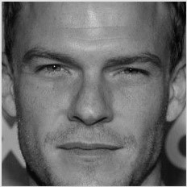
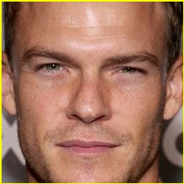
Data Preprocessing
Face detection, extraction and cropping
Done by Har Cascade Frontal Face

Slide 7
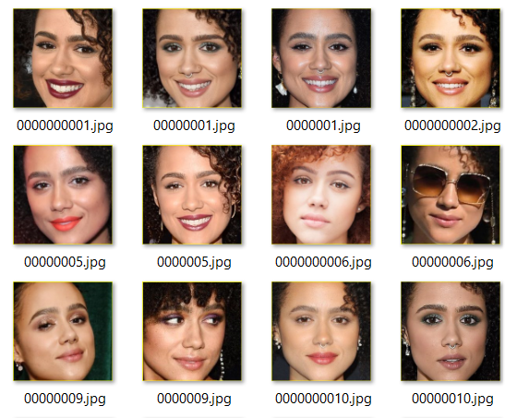
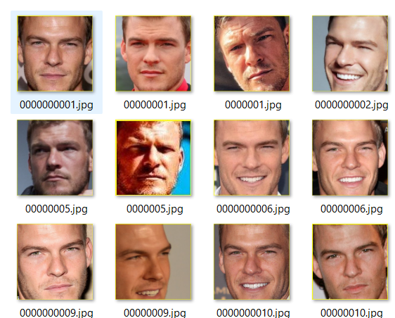
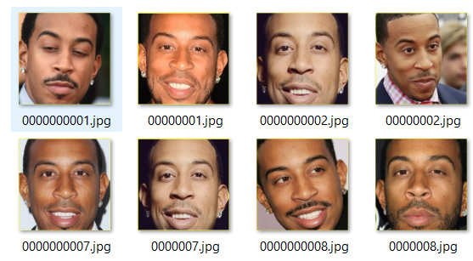
Valid Dataset

Slide 8
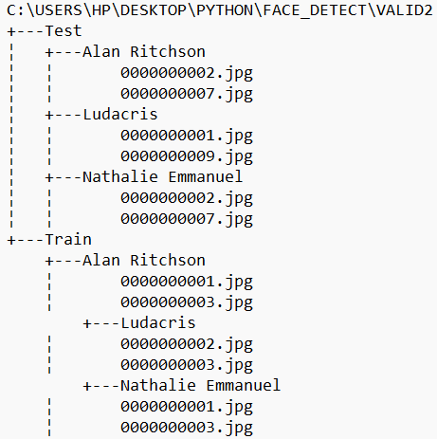
Data Preprocessing
Train/Test Split into 70-30
Library :-

Slide 9
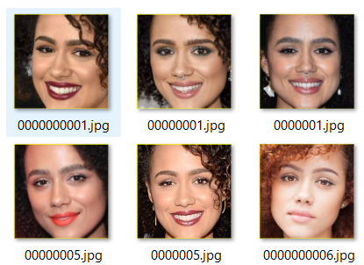
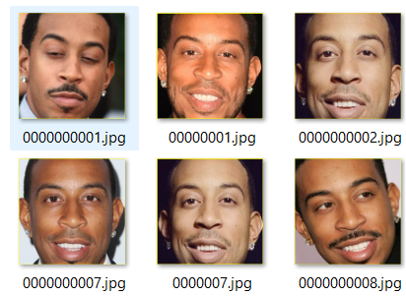
Feature Extraction and Classification
MTCNN
FaceNet
InceptionResNetV2()
Save Encoding/Features
As Pickle File
facenet_keras_weights
Haar Cascade
VGG16(Transfer Learning)
Save Encoding/Features
As H5
imagenet

Slide 10
Features/Encodings
{'Nathalie Emmanuel': array([-0.12498692, -0.15341993, 0.01112015, 0.0686309 , 0.03203177, 0.00538335, -0.01103027, 0.04894527, 0.01208874, 0.13119903, -0.20331289, 0.07774244, -0.08688483, -0.00453778, 0.05702018, 0.10756487, -0.00130893, 0.06902599, 0.00601771, -0.0726536 , 0.14885132, -0.09950729,], , 'Ludacris': array([-0.1630617 , -0.14465944, -0.04235595, 0.08112737, 0.06835084, -0.07925989, -0.06293663, 0.12057922, -0.05332515, 0.17532979, 0.05154599, 0.00256688, 0.03108589, -0.10000898, 0.03506746, 0.21384855, -0.02030437, 0.05270102, 0.03709633, -0.03602757, 0.01833219, -0.10996756, 0.05816747, 0.15524974, -0.03583858, -0.06029473, 0.08263476, 0.1127075 , -0.08681016, 0.00309873, 0.00171779, 0.02098964, 0.06159178, -0.02739557, 0.06723026)]

Slide 11
Face Recognition

Slide 12
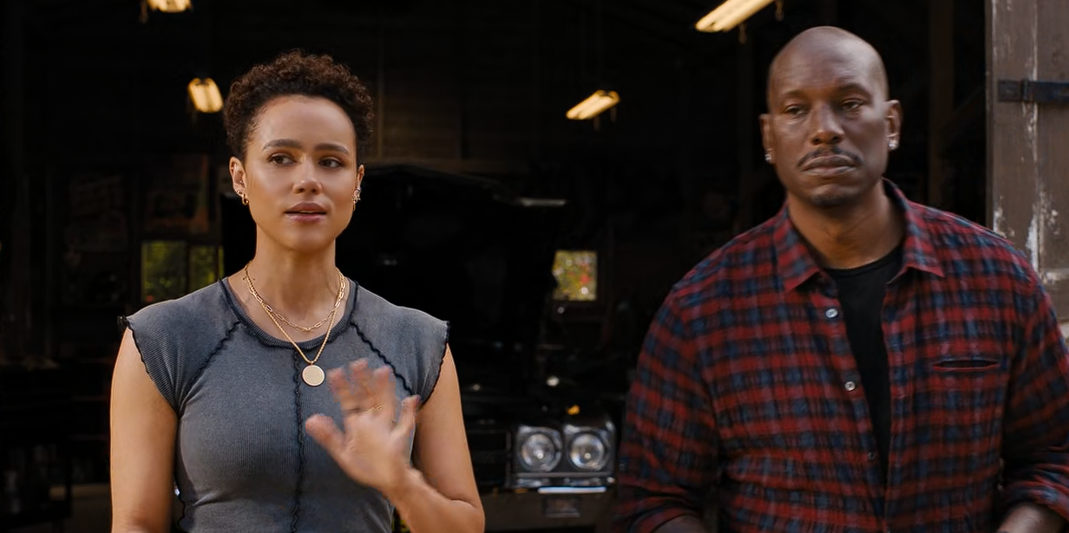
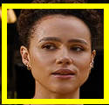
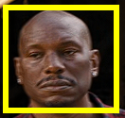
MTCNN/Haar Cascade
Single frame act as input to face detector
Act as input to model for prediction

Slide 13
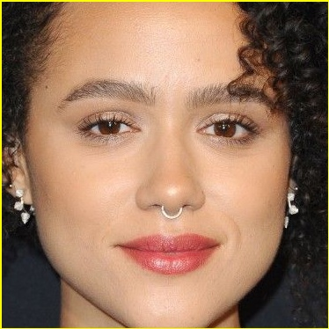
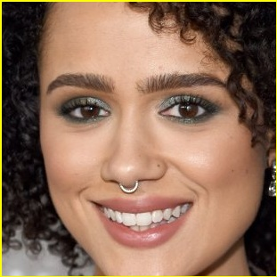
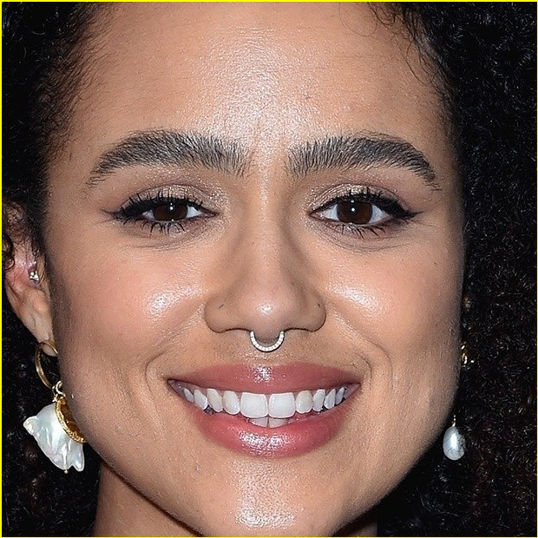
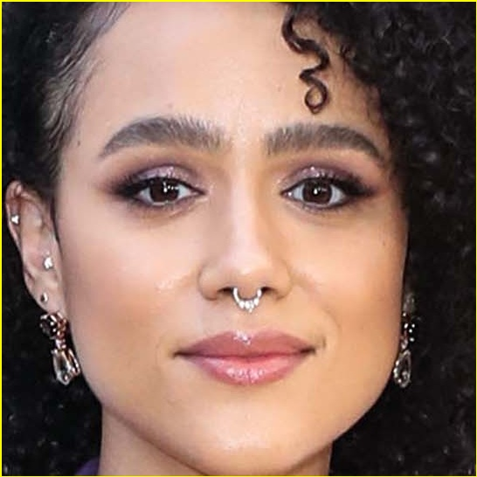
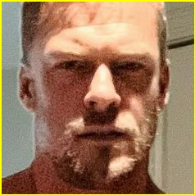
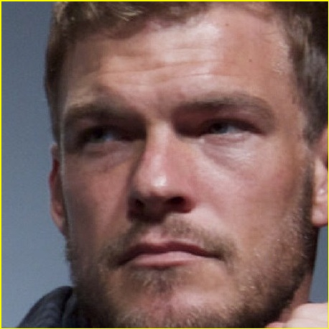
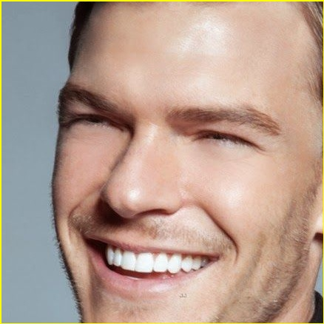


Slide 14
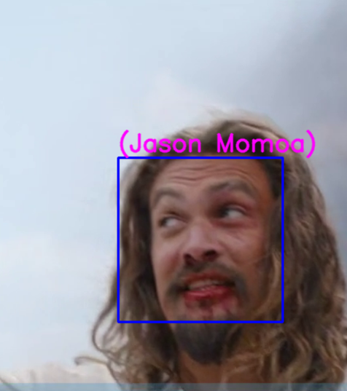
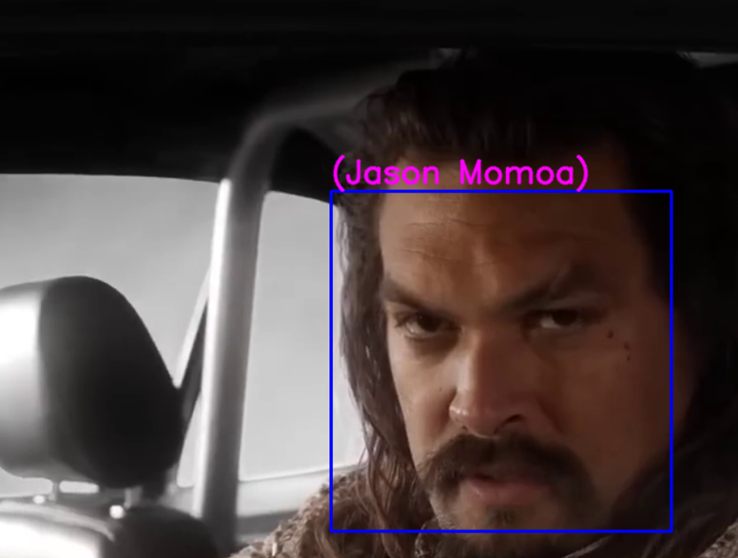
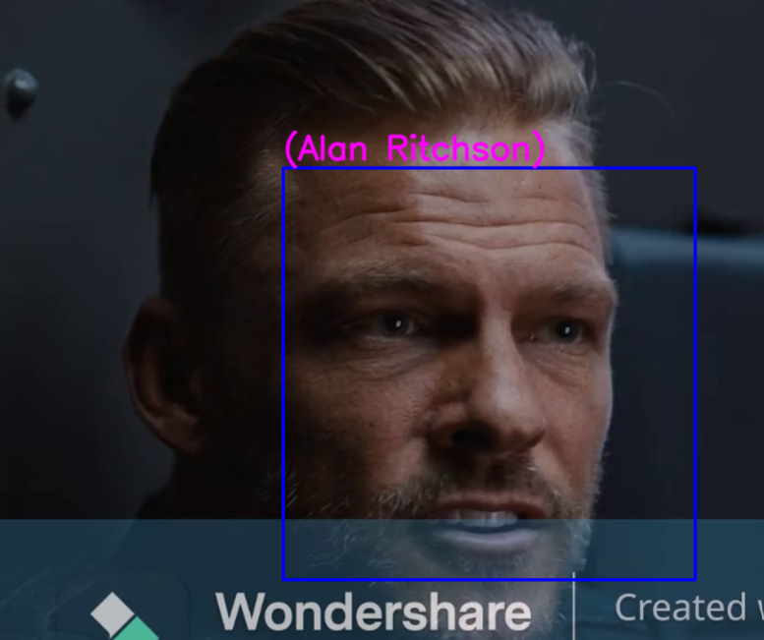
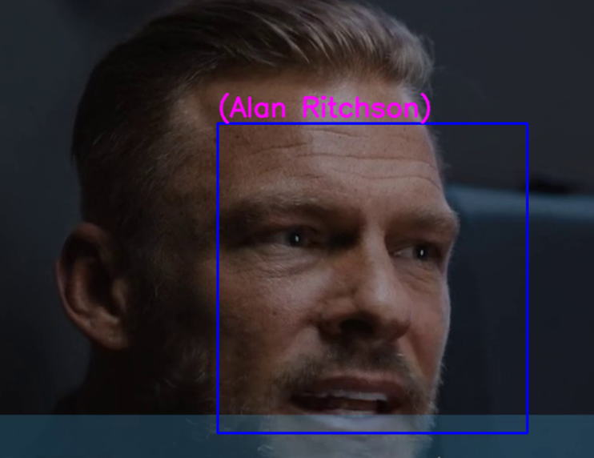
Predictions (Har Cascade + VGG16)

Slide 15
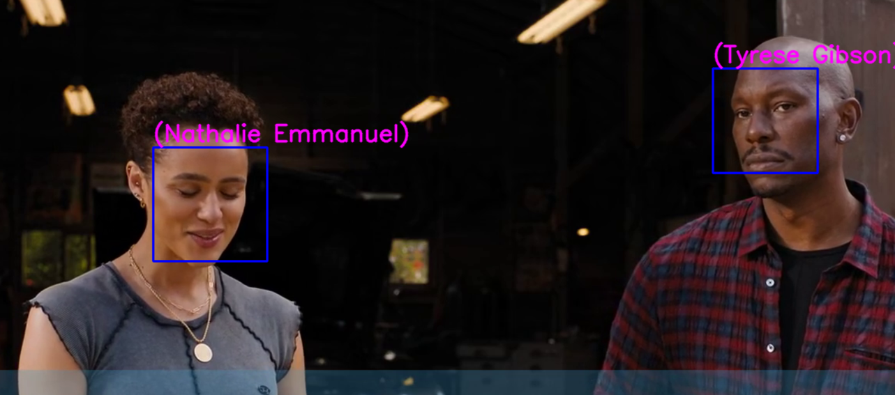
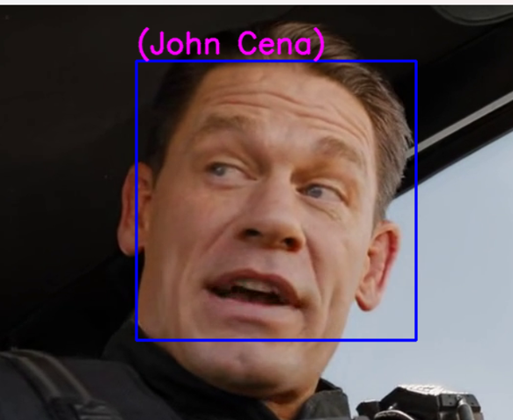
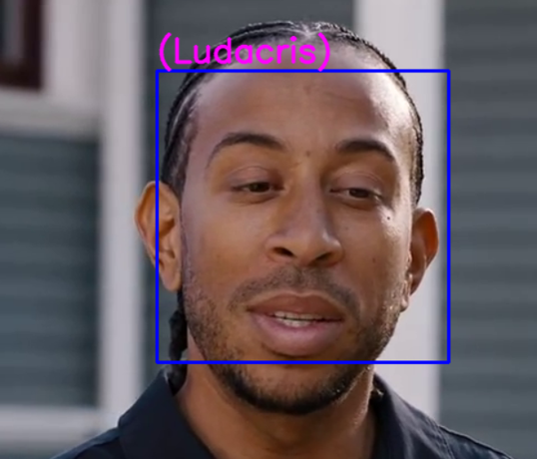

Slide 16
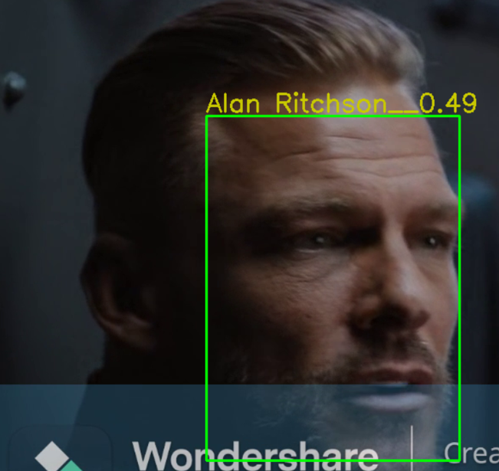
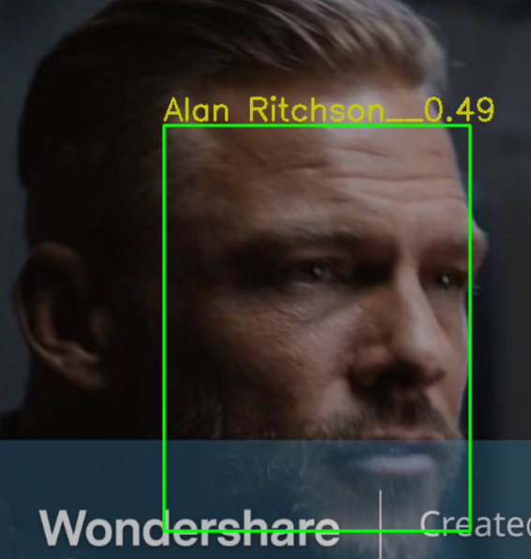
Predictions (MTCNN + Face Net)

Slide 17
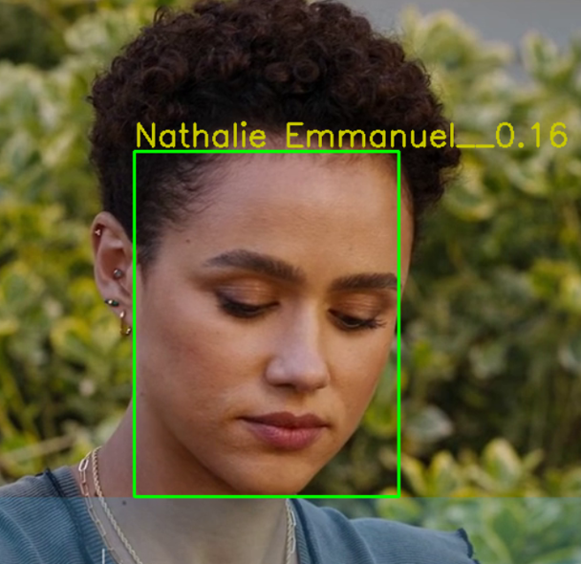
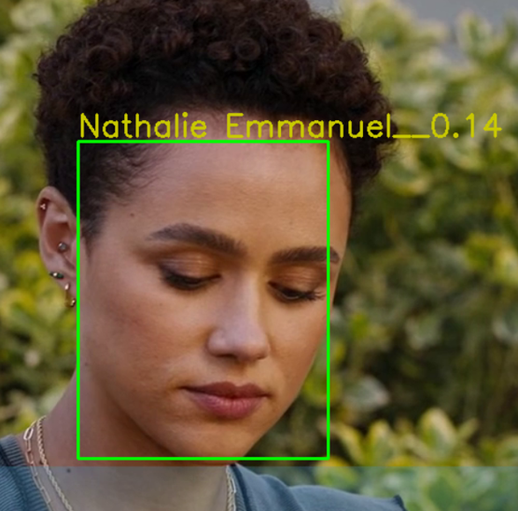
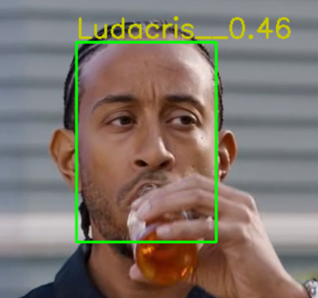

Slide 18
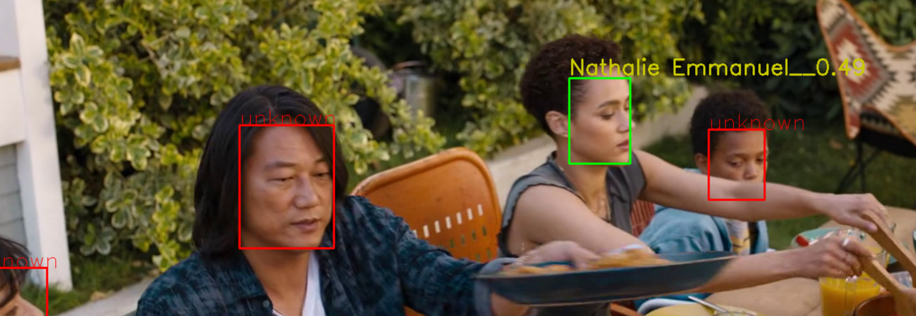

Slide 19
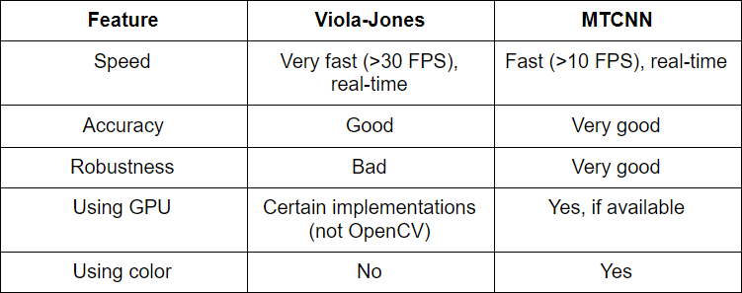
Conclusion:- Face Detection
On comparing face detection model i.e. Haar Cascade and MTCNN we conlude that haar cascade is much faster that MTCNN but it detect faces with less accuracy, So, if high computation hardware is available MTCNN is recommended.

Slide 20
Conclusion:- Face Recognition
 | FaceNet | VGG16
Training Objective | The main objective of FaceNet is to minimize the distance between embeddings of similar faces and maximize the distance between embeddings of different faces. | VGG16 is trained using a supervised learning approach to minimize the classification error on the training dataset.
Specialization | FaceNet is specialized for face-related tasks and is optimized for learning discriminative features from faces, making it well-suited for face recognition tasks. | VGG16 is a more general architecture and can be used for various image classification tasks beyond face recognition.
Performance | FaceNet's embeddings are highly effective for face verification and recognition tasks, achieving state-of-the-art performance on benchmark datasets. | VGG16 was influential at its time of introduction and achieved strong performance on image classification benchmarks. However, newer architectures have since surpassed its performance on various tasks.
On comparing two feature extraction model i.e. FaceNet and VGG16, VGG16 predicts with more accuracy.

